Slide 1
DATA ANALYTICS PROJECT
Adventure Works
Sales Performance Analysis
EXCEL
MySQL
TABLEAU
POWER BI
POWER QUERY
GROUP 4
Project Team — 7 Members & Roles
Akshay Rathod — Data Analyst
Pratyush Parashar — Business Analyst
Ega Venkat Sai — Data Analyst
Hitesh Prajapati — Data Analyst
Usirikayala Vishnu Vamsi — Data Analyst
Prashant Pankaj Singh — Data Analyst
Bathala Siva Kumar — Data Analyst
AdventureWorks Cycles | Multinational Sales Analysis | 2010–2014

Slide 2
PROJECT OVERVIEW
About Adventure Works Cycles
29.36M
Adventure Works Cycles is a large, multinational manufacturing company that designs and sells metal and composite bicycles across North American, European, and Asian commercial markets. Its base of operations is in Bothell, Washington, with 290 employees supported by regional sales teams worldwide. In the 2000s, the company acquired a manufacturing plant in Mexico that produces critical subcomponents, shipped to Bothell for final assembly. By 2001, this plant became the sole manufacturer and distributor of the touring bicycle product group. Coming off a successful fiscal year, Adventure Works Cycles aims to broaden market share by targeting its best customers, extending product availability through an external website, and reducing cost of sales through lower production costs.
TOTAL SALES
12.08M
TOTAL PROFIT
60.40K
TOTAL ORDERS
41.15%
PROFIT MARGIN
AdventureWorks Cycles | Sales Performance Analysis | Group 4
2

Slide 3
PROJECT ROADMAP
Four phases, one end-to-end analytics workflow
01
02
03
04
Excel
MySQL Workbench
Tableau
Power BI
Data cleaning, XLOOKUP/VLOOKUP, date fields, Sales & Production Cost formulas, Pivot Tables and charts.
Import Excel sheets, build tables with primary/foreign keys, joins, views and SQL queries.
Data relationships, calculated fields, KPI cards, filters and an interactive dashboard.
Power Query transformations, star-schema data model, DAX measures and interactive reports.
AdventureWorks Cycles | Sales Performance Analysis | Group 4
3

Slide 4
DATASET OVERVIEW
Fact and dimension tables that make up the data model
TABLE
PURPOSE
STAR-SCHEMA MODEL
FactInternetSales
Main sales transactions
Fact_Sales
Fact_Internet_Sales_New
Additional sales transactions (unioned)
DimCustomer
DimCustomer
Customer details
DimProduct
DimProduct
Product details
DimDate
DimDate
Date table
DimSalesTerritory
DimSalesTerritory
Regional / territory details
DimProductCategory
DimProductCategory
Product category
DimProductSubCategory
DimProductSubCategory
Product sub-category
AdventureWorks Cycles | Sales Performance Analysis | Group 4
4

Slide 5
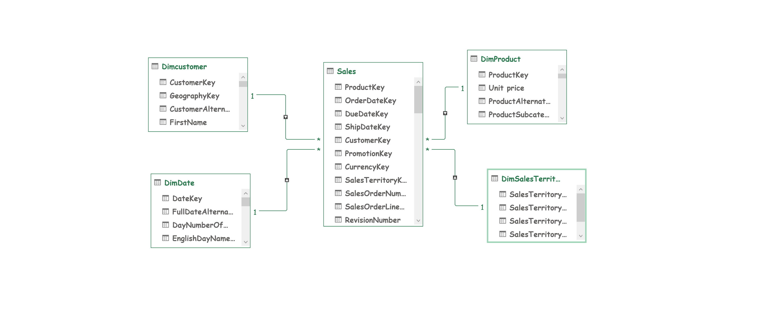
ADVENTURE WORKS DATA MODELING
Star-schema relationships linking the Sales fact table to six dimension tables
1 Fact Table • Sales
6 Dimension Tables
Star-Schema Design
AdventureWorks Cycles | Sales Performance Analysis | Group 4
5

Slide 6
DATA PREPARATION
Excel phase — cleaning, lookups & calculated fields
1
2
3
Union Sales Data
Lookups
Date Fields
Combined FactInternetSales and Fact_Internet_Sales_New into a single Sales sheet.
XLOOKUP / VLOOKUP for Product Name, Customer Full Name and Unit Price.
Derived Year, Month, Quarter, Year-Month, Weekday and Financial Month/Quarter from OrderDateKey.
4
5
6
Sales Amount
Production Cost
Profit
Unit Price × Order Quantity × (1 − Unit Discount).
Unit Cost × Order Quantity.
Sales Amount − Production Cost.
AdventureWorks Cycles | Sales Performance Analysis | Group 4
6

Slide 7
PROJECT QUESTIONNAIRE
Key tasks assigned across the analytics workflow
Data Prep & Calculations
Visual Analysis
KPIs & Dashboard
Union the two sales tables
Pivot table: month-wise sales, filtered by Year
Additional KPIs by Product, Customer & Region
Lookup Product Name, Customer Name & Unit Price
Bar chart — year-wise sales
One or more consolidated dashboards
Build Year / Month / Quarter / Financial-period fields
Line chart — month-wise sales
Calculate Sales Amount, Production Cost & Profit
Pie chart — quarter-wise sales
Combo chart — Sales Amount vs Production Cost
AdventureWorks Cycles | Sales Performance Analysis | Group 4
7

Slide 8
SQL ANALYSIS
MySQL Workbench — rebuilding the workflow in SQL
CREATE OR REPLACE VIEW v_UnionedSales AS SELECT * FROM factinternetsales UNION ALL SELECT * FROM factinternetsalesnew;
Data Foundation
Calculated Fields
Chart-Ready Queries
KPI Queries
Union FactInternetSales + FactInternetSalesNew into v_UnionedSales
Date parts from OrderDateKey (Year, Month, Quarter, Weekday, Financial Month/Qtr)
Monthly pivot filtered by Year
Top 10 Products by Sales
Lookup ProductName from DimProduct
Sales Amount = Price × Qty × (1 − Discount)
Year-wise & month-wise sales
Top 10 Customers by Sales
Lookup CustomerFullName & Unit Price
Production Cost & Profit
Quarter-wise sales
Sales Performance by Region
Combo: Sales Amount vs Production Cost
AdventureWorks Cycles | Sales Performance Analysis | Group 4
8

Slide 9
ADVANCED SQL ANALYTICS
Window functions & ranking queries in MySQL Workbench
1
Year-over-Year Growth
2
Monthly Running Total
3
Best Product Category
LAG() compares each year's sales to the prior year and computes YoY growth %.
A cumulative sales total build month by month across the full order history.
Joins Product → SubCategory → Category and ranks total sales to find the #1 category.
LAG() OVER (ORDER BY SalesYear)
SUM(...) OVER (ROWS UNBOUNDED PRECEDING)
GROUP BY Category ORDER BY Sales DESC
4
Highest Profit Products
5
Customer Ranking
6
Reusable View Layer
Top 10 products ranked by Sales Amount minus Production Cost.
Every customer ranked by total spend, with ties handled correctly.
All 17 queries run against a single v_UnionedSales view — one source of truth for every chart.
ORDER BY TotalProfit DESC LIMIT 10
DENSE_RANK() OVER (ORDER BY Sales DESC)
CREATE OR REPLACE VIEW v_UnionedSales
AdventureWorks Cycles | Sales Performance Analysis | Group 4
9

Slide 10
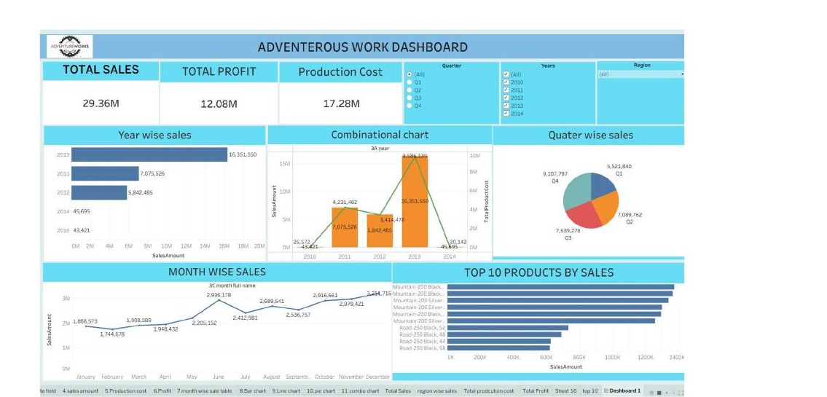
TABLEAU DASHBOARD I
Sales overview — year, quarter & monthly trends, top products
Visualizations Used
KPI Cards
Total Sales, Total Profit & Production Cost at a glance
Bar + Line Combo
Year-wise sales plotted against production cost
Pie Chart
Quarter-wise sales distribution across Q1–Q4
Line Chart
Month-wise sales trend across the year
Bar Chart
Top 10 products ranked by sales amount
Slicers
Filter the view by Quarter, Year & Region
AdventureWorks Cycles | Sales Performance Analysis | Group 4
10

Slide 11
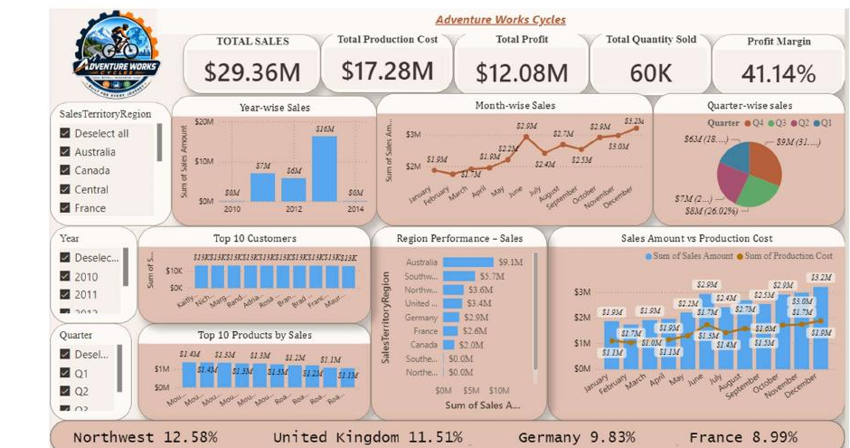
POWER BI DASHBOARD II
Regional & customer insights with interactive slicers
Visualizations Used
KPI Strip
Sales, Cost, Profit, Quantity & Profit Margin
Bar Chart
Year-wise sales split by sales territory
Line + Pie Charts
Month-wise trend and quarter-wise sales share
Bar Charts
Top 10 customers and top 10 products by sales
Combo Chart
Sales amount vs. production cost by month
Slicers
Region, Year & Quarter interactive filters
AdventureWorks Cycles | Sales Performance Analysis | Group 4
11

Slide 12
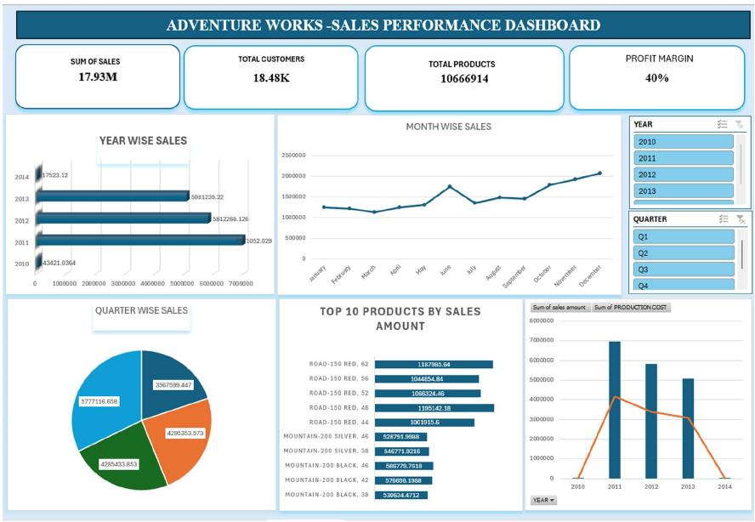
EXCEL DASHBOARD III
Sales performance summary — year, quarter & product view
Visualizations Used
KPI Cards
Sum of Sales, Customers, Products & Profit Margin
Bar Chart
Year-wise sales trend, 2010–2014
Line Chart
Month-wise sales pattern across the year
Pie Chart
Quarter-wise sales contribution
Bar Chart
Top 10 products by sales amount
Combo Chart
Sales vs. production cost with Year & Quarter filters
AdventureWorks Cycles | Sales Performance Analysis | Group 4
12

Slide 13
KEY INSIGHTS
AdventureWorks sales analysis | 2010 – 2014
29.36M
12.08M
60.40K
41.15%
$486.09
TOTAL SALES
TOTAL PROFIT
TOTAL ORDERS
PROFIT MARGIN
AVG ORDER VALUE
1
Peak Year: 2013
2
Top Region: Southwest
3
Top Product
2013 was the highest sales year at 16M — 2.7x higher than 2012, with significant growth from 2011 onward.
Southwest USA led all regions; Australia was the top international market with 9.06M in sales.
Mountain-200 Black (42) was the best seller at 1.37M — mountain bikes dominate the top 10 products.
4
Top Customer
5
Q4 Peaks Sales
6
Sales > Cost
Jordan Turner leads with 16.00K in purchases; the top 10 customers are closely ranked between 13–16K.
Q4 is consistently the strongest quarter — the holiday-season effect is visible across all years.
Production cost stays well below the sales amount across all months — a healthy, stable margin of 41.15%.
AdventureWorks Cycles | Sales Performance Analysis | Group 4
13

Slide 14
TOOLS & TECHNOLOGY STACK
The full analytics toolkit used across this project
1
2
3
4
Excel
MySQL Workbench
Tableau
Power BI
Data cleaning, lookups, pivot tables, charts & dashboards
Table design, joins, views & SQL queries
Data relationships, calculated fields & interactive dashboards
Power Query, data modeling, DAX measures & reports
AdventureWorks Cycles | Sales Performance Analysis | Group 4
14

Slide 15
THANK YOU
Adventure Works — Sales Performance Analysis | Group 4
Excel • SQL • Tableau • Power BI

